Slide 1
Overview of our COVID-Response Work

Slide 2
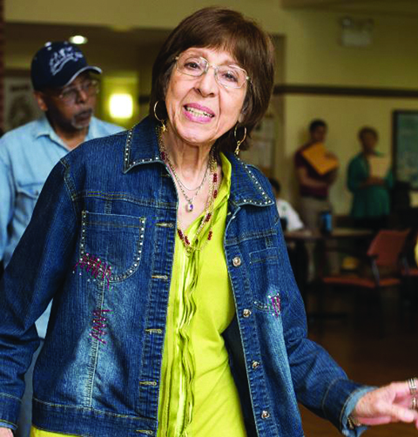
01.
Our Mission
AgeOptions innovates, partners, and advocates to improve systems and services in order to strengthen communities so people thrive as they age.
02.
Our Vision
Connecting,
Innovating,
Advocating.
Empowering people to thrive as they age.
People thriving as they age
03.
Our Values
Commitment
Integrity
Connectedness

Slide 3
Area Agency on Aging for suburban Cook County
Plan, fund, coordinate and advocate for services for older adults, people with disabilities and the people who care for them
Network of partners delivering services throughout suburban Cook County

Slide 4
Area Agency on Aging for suburban Cook County
Key Services
Congregate and Home Delivered Meals
Aging and Disability Resource Network
Information and Assistance
Benefits screening and enrollment
Senior Health Insurance Program
Adult Protective Services
Caregiver Resource Centers
Includes Grandparent Raising Grandchildren
Health Promotion and Disease Prevention

Slide 5
COVID-Response Programming
Expanded Meals
Top Box
Social Isolation Prevention
Uniper
Good Times Choir
Memory Cafes
Library Program
Online health promotion programming
Self-Management
Falls

Slide 6
COVID-Response Programming
Mental Health
Rush UMC Counselor
Economic Downturn Assistance
Center for Disability and Elder Law foreclosure prevention programming
Emergency Senior Services (ESS) grant funding

Slide 7
COVID-Response Programming
Vaccination Assistance
ADRNS can help with registration
ESS funds can be used to pay for transportation to vaccinations
Setting up clinics for high-risk older adults who could not attend general vaccination sites

Slide 8
Resources
To find your local service provider:
https://services.ageoptions.org/
Information and Asistance:
(708)383-0258
information@ageoptions.org
www.ageoptions.org

Slide 9
Thanks

