Slide 1
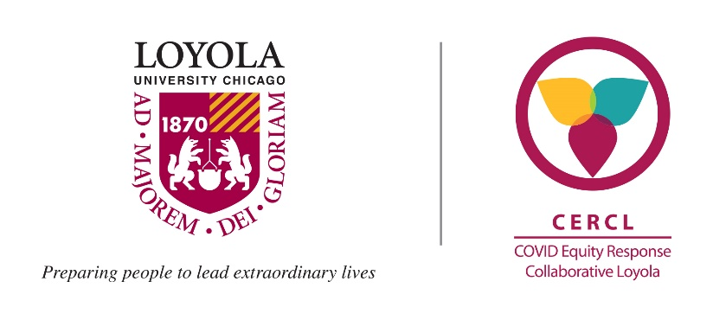
COVID Equity Response Collaborative Loyola (CERCL): Understanding COVID-19 Transmission in Communities of Color
Notes:
Good morning, I’m Abigail Silva an epidemiologist and assistant professor in the Department of public health sciences
And one of the leads of CERCL
and am delighted to share our team’s update with you.

Slide 2
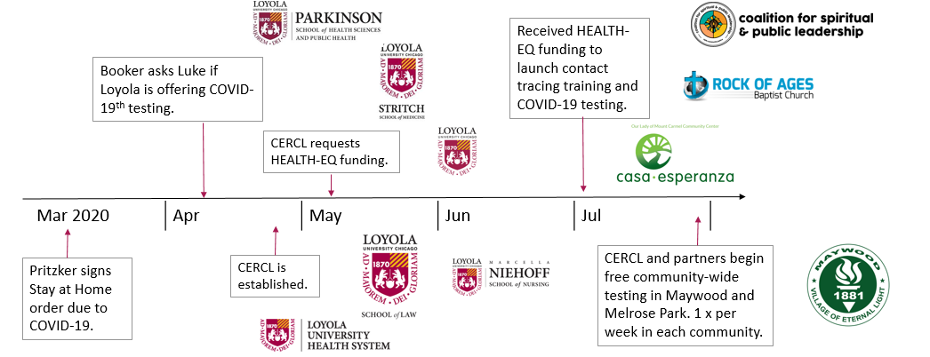
A Brief History
CERCL requests Walder Foundation Funding
Restart and Expand testing!
CERCL requests CCDPH/Hektoen funding for community supports
Received PT MHC grant!
Aug | Sep | Oct | Nov | Dec
Received Walder Foundation funding!
Received CCDPH/Hektoen funding!

Slide 3
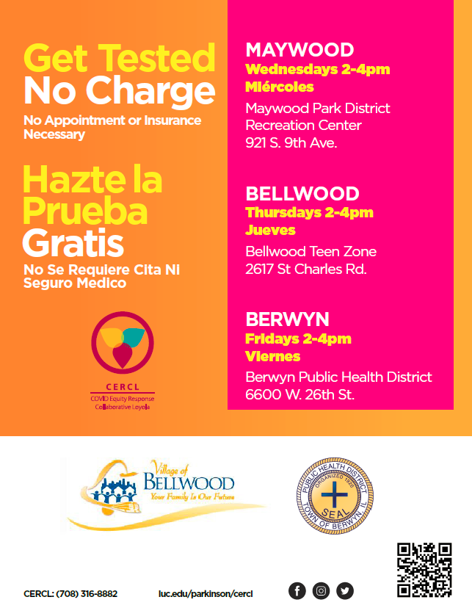
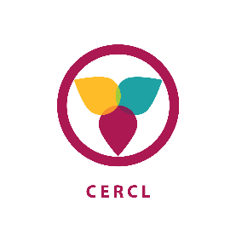
COVID-19 Testing
3 Testing current sites
Maywood Park District Recreation Center (Nov 2020)
Berwyn Public Health District (Jan 2021)
Bellwood Teen Zone (Mar 2021)
526 participants tested and screened for social and legal needs
699+508= 1,225 (since July 2020)
PROGRESS TO DATE (2/22/2021)
Notes:
We began testing in Maywood this past November
And in Berwyn last month
Next week we start in Bellwood.
Since November we have tested over 500 residents and worked with the Health Justice Project, a medical legal partnership out of the law school.. To screen everyone for social and legal needs.
In total however, CERCL has tested over 1200 residents since the summer when we first began offering free testing in the community.

Slide 4
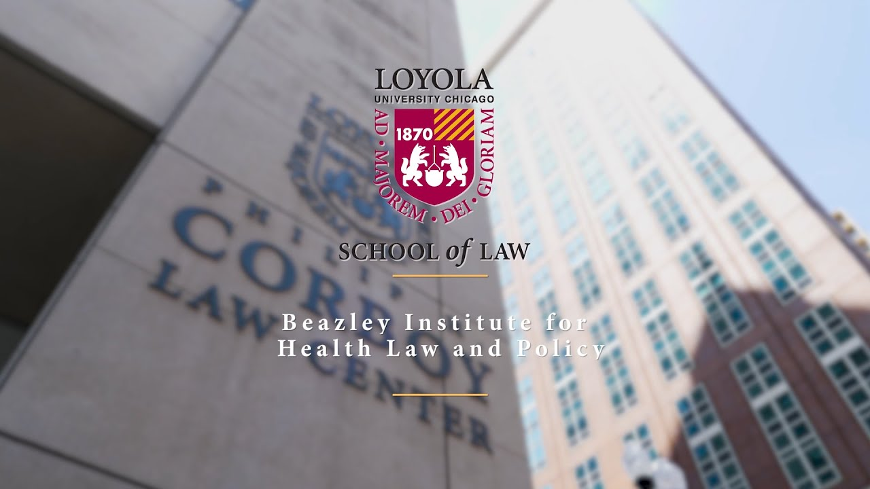
Supporting Social and Legal Needs
Screened over 350 community members for social and legal needs
Followed up with 150 who indicated they had a need and wanted to be contact about it.
Needs:
54% indicated no health insurance
59% indicated no primary care provider
80% reported loss of income
66% reported financial struggles
40% reported concerns related to remote education
19% reported safety concerns
11% reported concerns about an upcoming court date

Slide 5
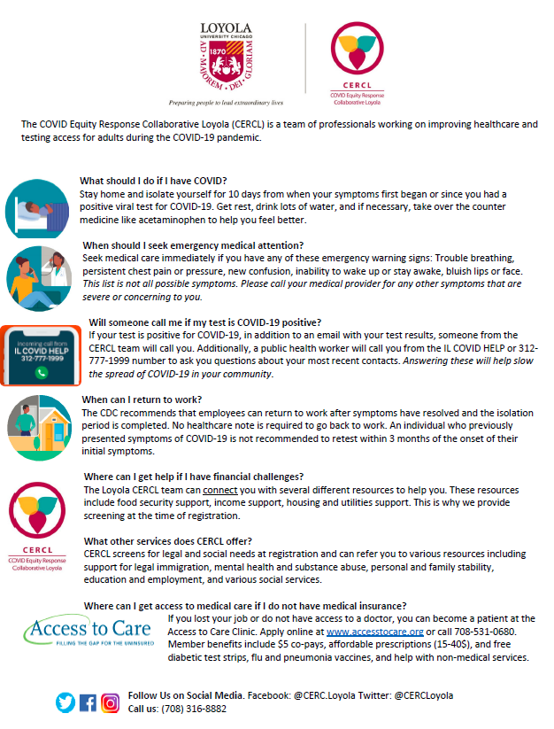
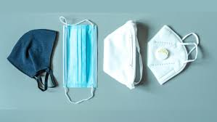
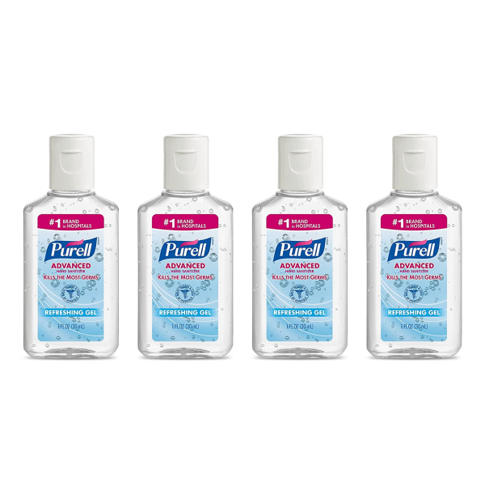
COVID-19 Contact Tracing Community Supports Program (Dec 20-May 21)
Execute a localized outreach and education campaign to disseminate bilingual COVID-19-related information to our target communities
Increase testing through an aggressive communication campaign
Improve linkages to local community resources
Provide necessities to lessen the impact and spread of COVID-19
Notes:
Margarita Klein, Arise Chicago
Elizabeth Young, Quinn Center of St. Eulalia in Maywood
Deniene Willis, leads Community Leadership Academy for Proviso Partners for Health
Anna Sikora, Pillars Community Health

Slide 6
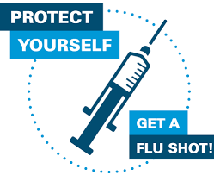
Why are we doing this?
Community-wide testing is critical to keeping our communities safe and working.
Bringing resources to our communities.
Providing opportunities for our communities to be a part of research.
Co-develop a sustainable infrastructure that helps keep our communities safe and healthy.
As of March 10.2021 | 7-day Test Positivity*
Cicero | 3.4%
Melrose Park | 2.8%
Berwyn | 4.4%
Bellwood | 3.2%
Maywood | 5.0%
Suburban Cook County | 3.2%**
Chicago | 2.7%
**https://www.dph.illinois.gov/regionmetrics?regionID=10
*http://covid-dashboard.fsm.northwestern.edu/
Notes:
Our five communities have high rates of COVID cases and levels of positive COVID tests.
Free testing
Screening for and linkage to social, financial, and legal resources.
Participation is optional but important for Black and Brown residents to have the opportunity.
Work with partners for equitable COVID vaccination access, acceptance, and uptake.

Slide 7
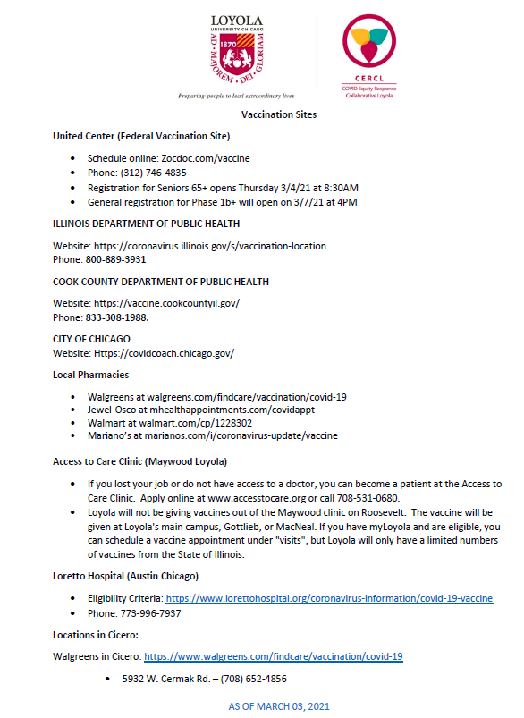
Vaccines
Providing information.
Assisting with vaccine registration.
Supporting partners as vaccination sites.
Seeking ways to help vaccination efforts.

Slide 8
ACKNOWLEDGEMENTS
Cadre of 100+ Volunteers
Physicians, nurses, faculty, students
Research/Project staff/interns
9 research investigators and 3 clinical staff
8 students/interns
2 community liaisons
Many governmental and community partners

