Slide 1
Employment Opportunities and Resources at Rush University Systems for Health
April 15, 2021
Presented by: Kevin Irvine, Senior Talent Acquisition Consultant, Individuals with Disabilities

Slide 2
Rush Is A Place of Healing
Rush University System for Health (RUSH) is an academic health system whose mission is to improve the health of the individuals and diverse communities it serves through the integration of outstanding patient care, education, research and community partnerships.
RUSH comprises Rush University Medical Center, Rush University, Rush Copley Medical Center and Rush Oak Park Hospital, as well as numerous outpatient care facilities.
I C.A.R.E. Values
Innovation Asking questions that challenge the status quo. Testing new ideas and being willing to take risks to achieve our vision.
Collaboration Partnering with others to leverage the strengths of each. Engaging in honest conversations that make the team better.
Accountability Taking ownership and keeping commitments. Speaking up and encouraging others to speak up.
Respect Using appropriate strategies and solutions for dealing with or diffusing workplace differences. Acknowledging others and expressing gratitude.
Excellence Doing everything possible to ensure the best outcomes. Keeping patient service at the center of everything we do.
About Rush University System for Health | Rush System
Notes:
-https://www.shrm.org/resourcesandtools/tools-and-samples/toolkits/pages/understandinganddevelopingorganizationalculture.aspx
-https://www.rush.edu/about-us/rush-health-care-education-research-not-profit-Chicago
Make distinction of 3 Rush locations, open to apply to all. Review ICARE, ask attendees to consider how they exemplify these values.

Slide 3
Rush Employment Roles
Clinical Roles
Patient Care Technician (PCTs)
Certified Medical Assistants (CMAs)
Phlebotomist
Certified Pharmacy Technician
Non-Clinical
Patient Services Representative
Patient Access Coordinator
Supply Chain Tech
Environmental Service Specialist (EVS)
Guest Relations Associate
Security Officer
Clinic Coordinator
Food Service Assistants
Patient Transporters
Community Health Worker
Applicants can search all available positions by department, specialty, and key word, i.e., coding
www.rush.edu/careers
Notes:
Include in attendee folders RUMC/ROPH job highlight sheets
Open web browser to Rush Careers - review current jobs in real time.
Ask if someone has a specific job they would like to look at.

Slide 4
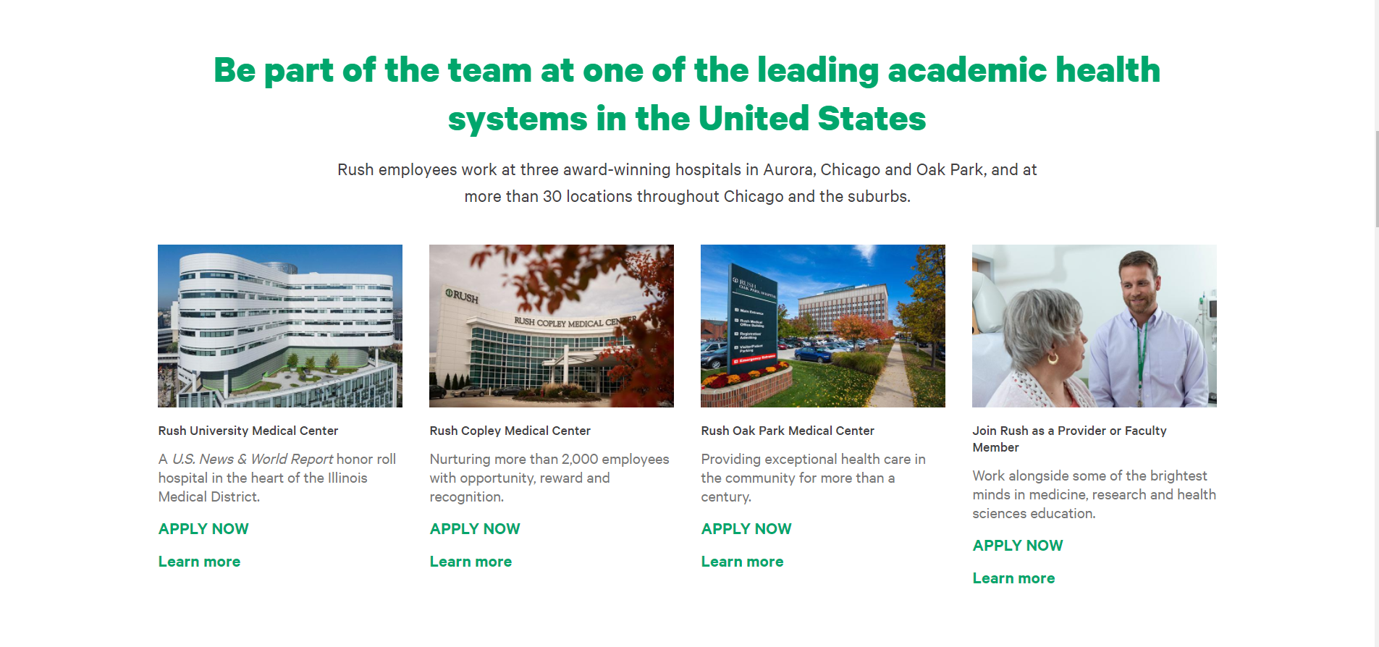
www.rush.edu/careers

Slide 5
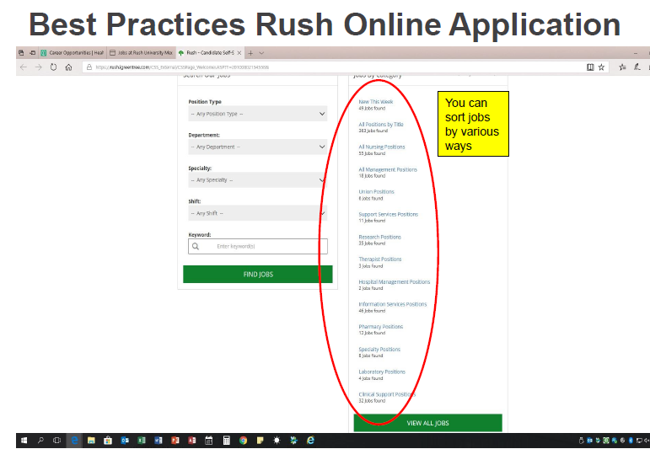

Slide 6
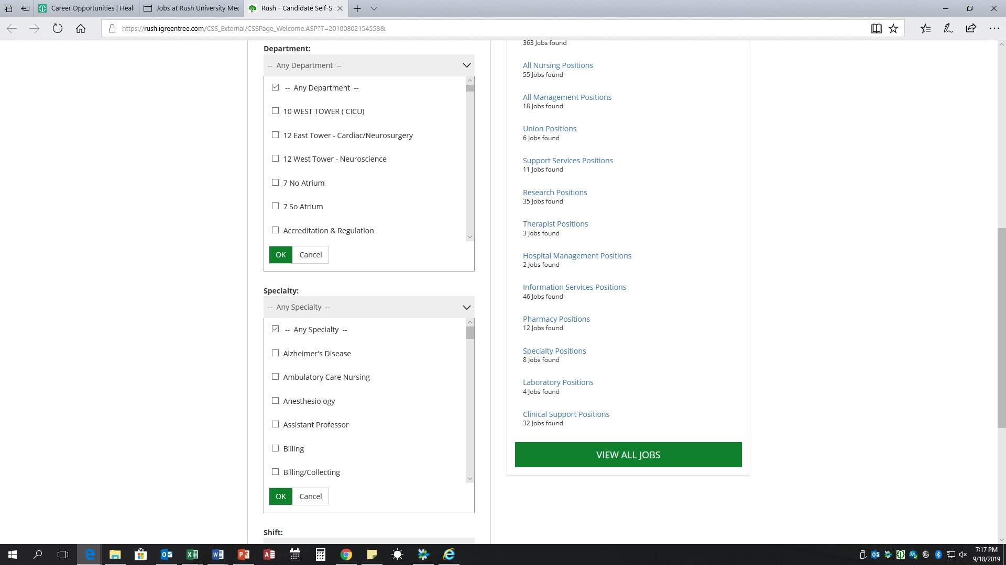
Best Practices Rush Online Application
You can sort jobs by various ways

Slide 7
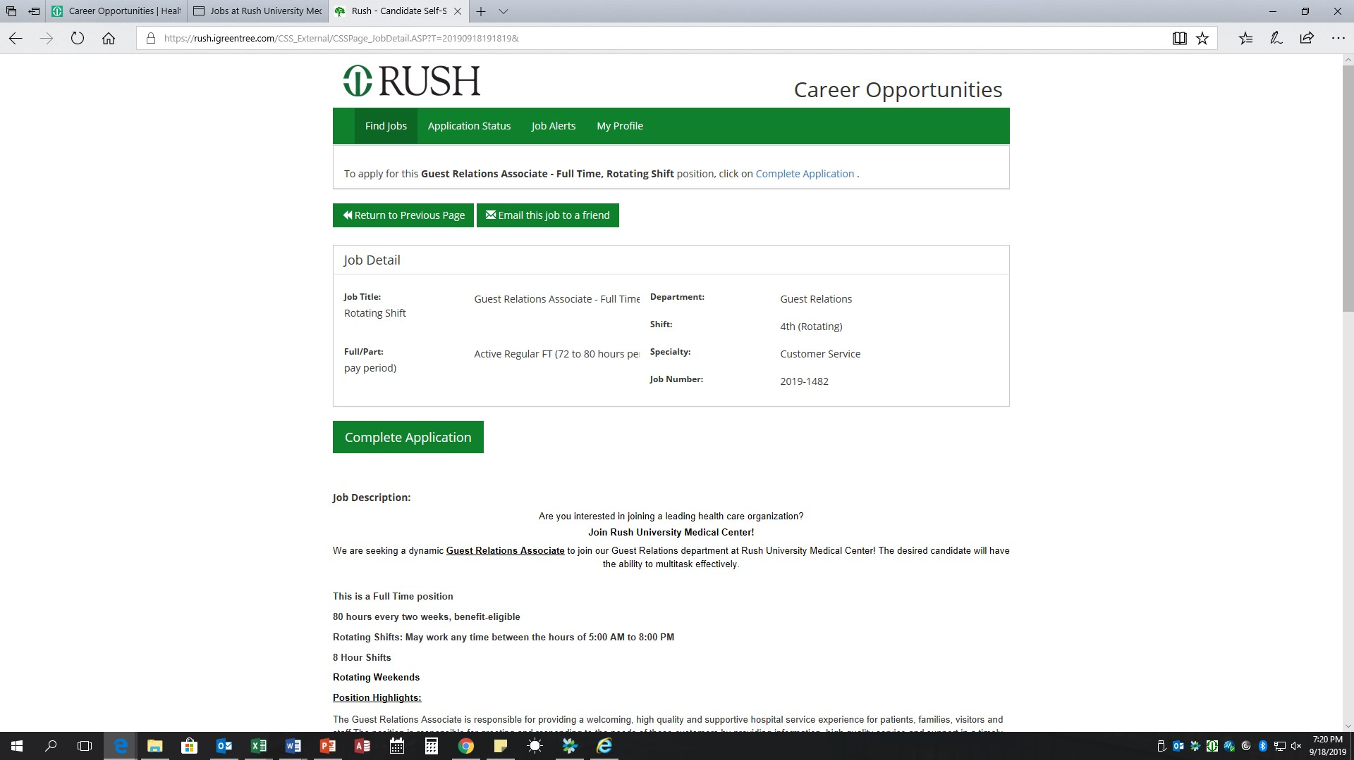
Best Practices Rush Online Application
Key information about position’s shift and union status

Slide 8
Application Best Practices
Read the entire job description and do not rush through the application
Make sure you meet all required qualifications Consider if you do not have the preferred qualifications
Be prepare to explain (essay questions) how your skills, education, and previous experience prepared you for success in the new role
Answer questions in full sentences, with proper grammar, and punctuation
When asked to provide more detail, do just that, not a few word answers. This is an opportunity to show how you are the best candidate for the position
For questions that do not pertain to you, enter N/A non-applicable
Deeply consider the “Why do you want to work for Rush” question; Rush is more than “a good place to work”
Consider the shift, department, and/or specialty you are applying to
Make sure the resume matches the jobs you added on your profile

Slide 9
Questions

